Slide 1
Hockey 101 (hockey for beginners)
Team Singapore hockey player Laura Tan talks us through the basic steps to the different types of skills in field hockey. Join her and SG Sports TV host Gary Yang on this journey towards improving your hockey basics

Slide 2
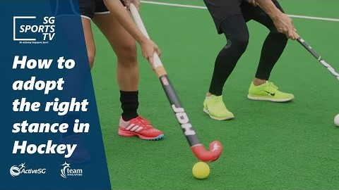
How to adopt
the right
stance in
hockey

Slide 3
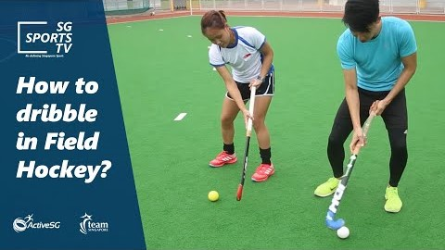
How to
dribble in
hockey

Slide 4
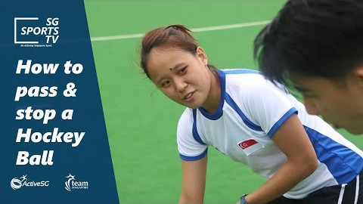
How to pass &
stop a hockey
ball

Slide 5
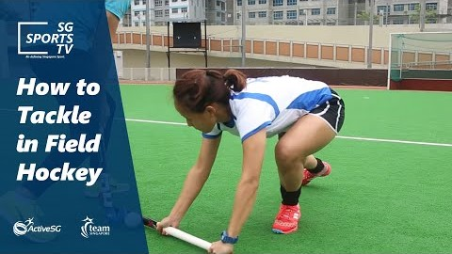
How to tackle
in hockey

