Slide 1
Skills by Hertzberger Field Hockey Training Videos
International Dutch player Jeroen Hertzberger demonstrates the finer skills of hockey in the following videos

Slide 2
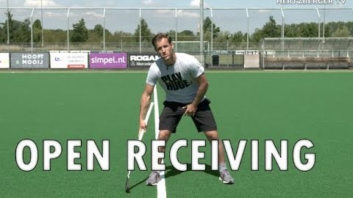
Open
Receiving

Slide 3
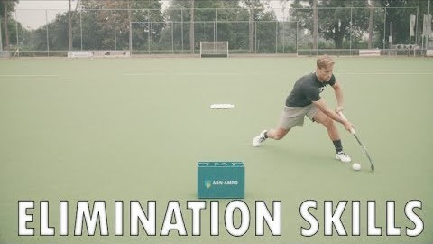
Elimination
skills

Slide 4
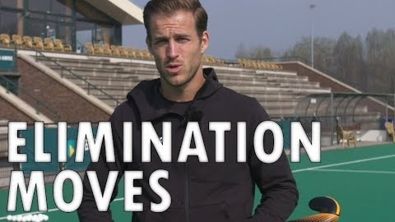
Elimination
moves

Slide 5
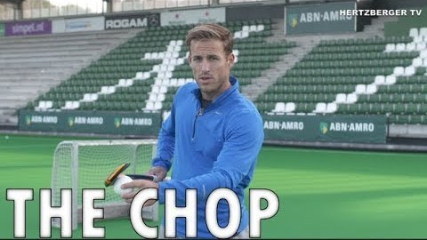
The Chop

Slide 6
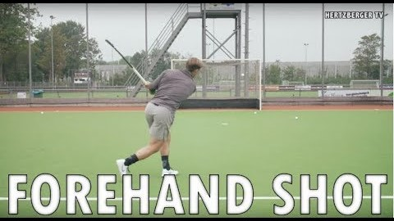
Forehand
Shot – the hit

Slide 7
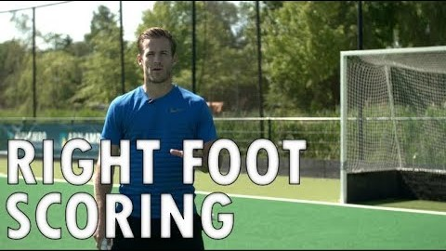
Right foot
scoring

Slide 8
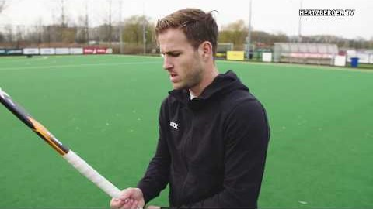
Reverse pass

Slide 9
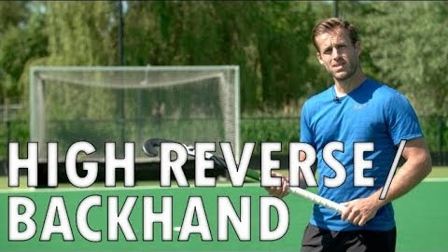
High Reverse
Backhand

Slide 10
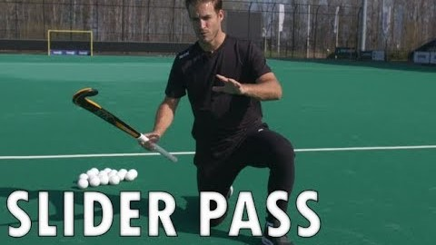
Slider Pass

Slide 11
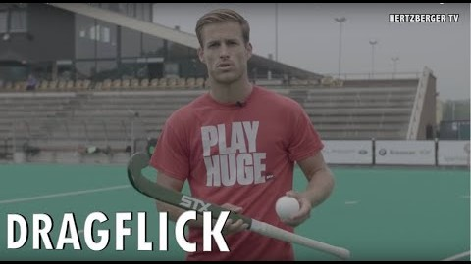
Drag Flick

Slide 12
Extra Skills

Slide 13
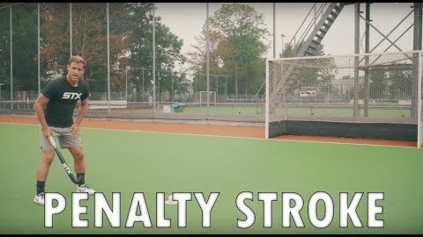
Penalty
Stroke

Slide 14
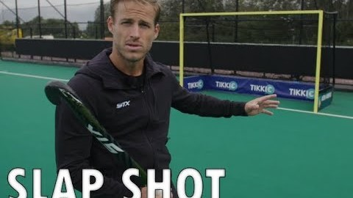
Slap Shot

Slide 15
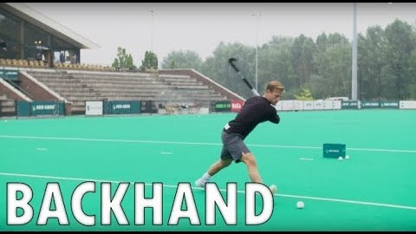
Backhand
shot

